Slide 1
Digital Image Processing
MEHMET BAYRAM ALPAY
20290310

Slide 2

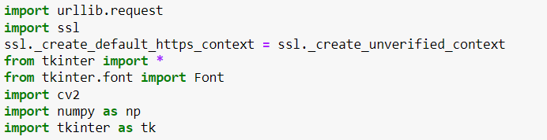
My all libraries that I used in my program. urllib.request provides to get photograph from internet I import ssl to get rid of chromes security for programming language tkinter and tkinter.font display the main window, labels, and buttons etc. opencv and numpy make filtering and output easy

Slide 3
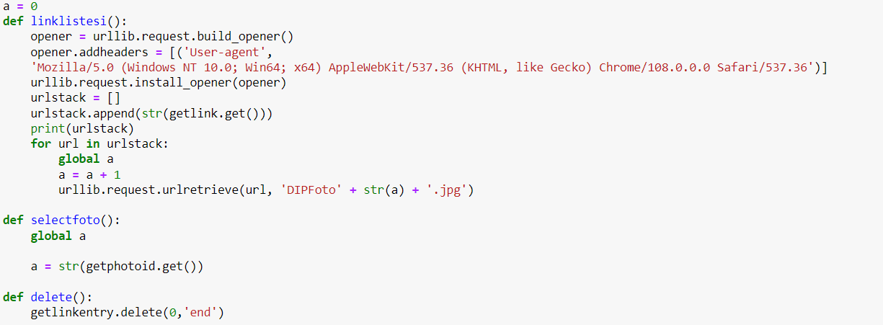
I define a variable named 'a' to give each photo a separate name and I can access the photos directly thanks to this variable. The urlstack array keeps all link that user entered and download them from internet. The selectphoto function makes the value of the global variable a equal to the a value of the photo to be processed. The delete function empties the photo link box.

Slide 4
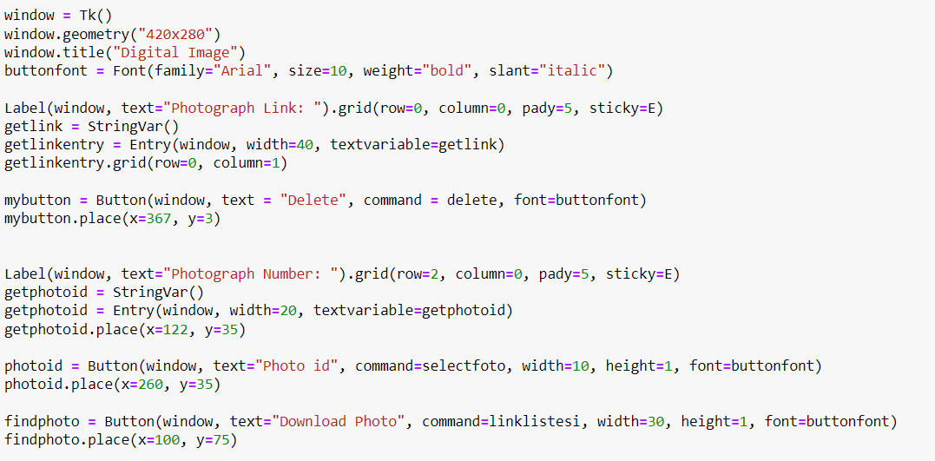
I created Tk() class and named as window. Buttonfont sets text style, size, weight, slant properties of all buttons. There are 2 labels, one for the photograph link and the other for the photograph number. Mybutton call the delete function, and also place the button at x=367, y=3 getphotoid creates a StringVar() that get input from user. Photoid calls the selectfoto function, it takes numbers as input. Findphoto button download the photograph from the internet using the linklistesi function.

Slide 5
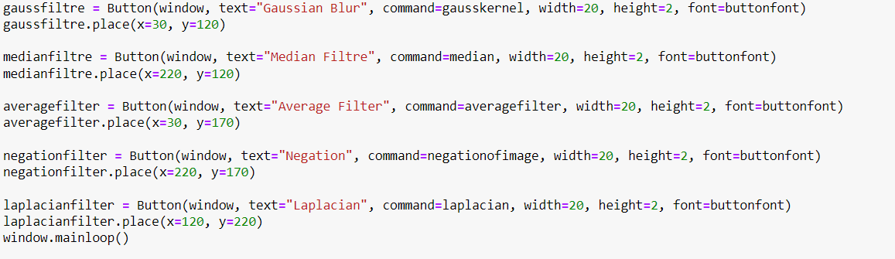
I created button for every filter, and named them all like 'gaussfiltre', 'medianfiltre', 'averagefilter', 'negationfilter', 'laplacianfilter'. I gave the functions I created for each feature to the buttons as command parameters To design the gui program, I set the pixel values ​​in the x and y planes using the place function.

Slide 6
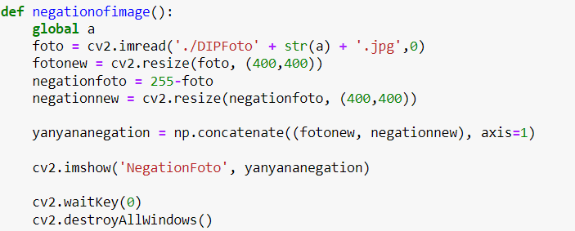
Negationofimage function call 'a' variable as global. To get photo to use cv2.imread function. Negationfoto apply 255-foto process for every pixel. Cv2.resize function adjust photograph size. Np.concatenate gives outputs as 2 photos side by side. Cv2.imshow get window name, and concatenated photos.

Slide 7
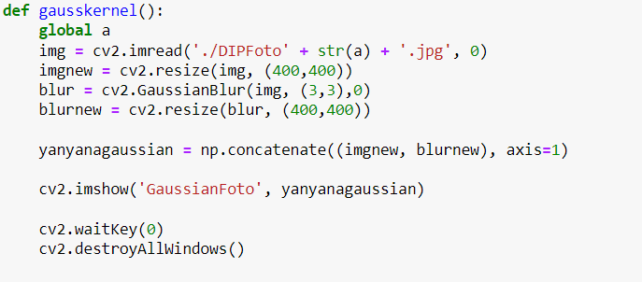
The logic of this function is the same as the previous function. Cv2.imshow, cv2.waitKey, cv2.destroyAllWindows, global a, np.concatenate, cv2.resize and img are the same properties as the previous function. Blur equals to cv2.GaussianBlur. Gaussian Blur creates a 3-3 gaussian kernel and takes the photo.

Slide 8
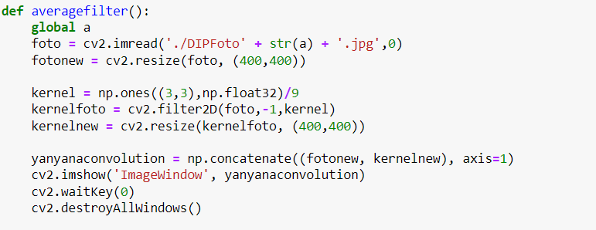
The function uses the value 1 to create a 3-3 kernel. Cv2.filter2d applies the 2D kernel to the 2D image. Others are same.

Slide 9
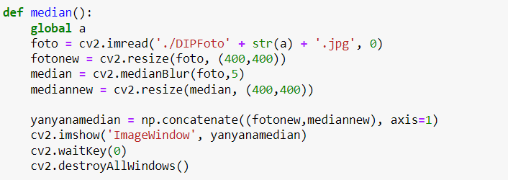
The logic of this function is the same as the previous functions. Median function finds the median value of the pixels, and apply the value to pixels that determined before. To do this, I used cv2.medianBlur function first parameter is photograph, and second is kernel number.

Slide 10
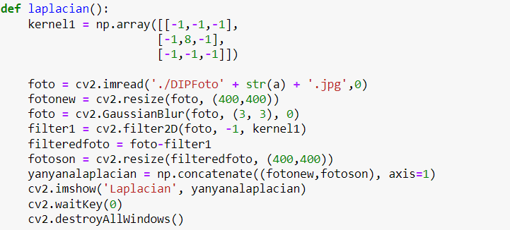
First, I created 3-3 numpy arrays and gave the midpoint a value of 8 and the other points a value of -1 to make a laplacian filter. I used Cv2.GaussianBlur function like previous one. Filter1 apply the kernel1 to the photograph. Last, I show my outputs using cv2.imshow().

Slide 11
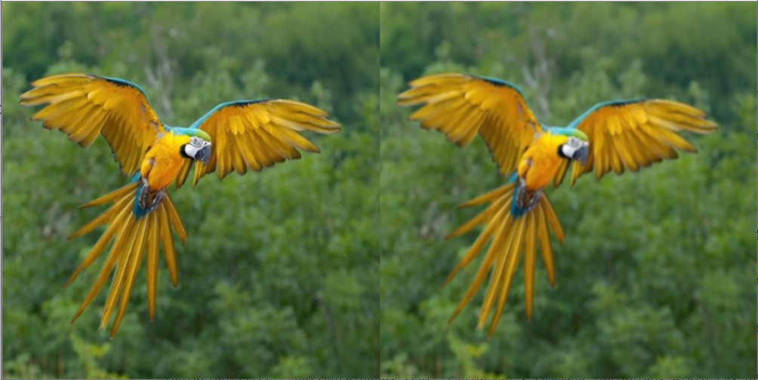
AVERAGE FILTER

Slide 12
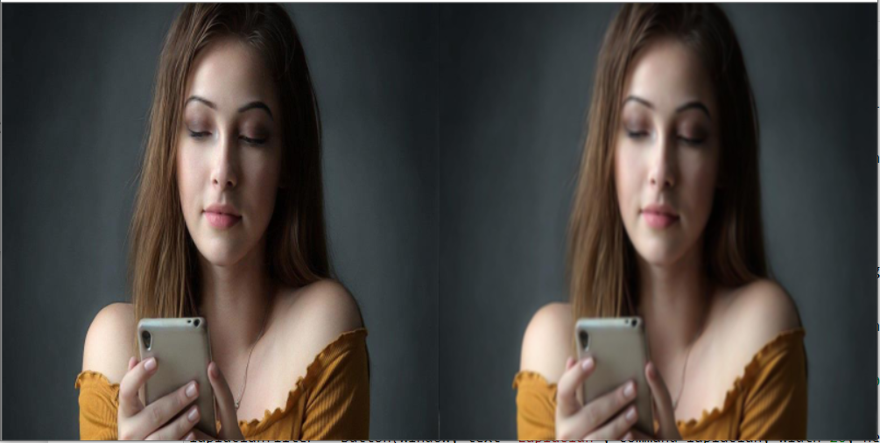
AVERAGE FILTER

Slide 13
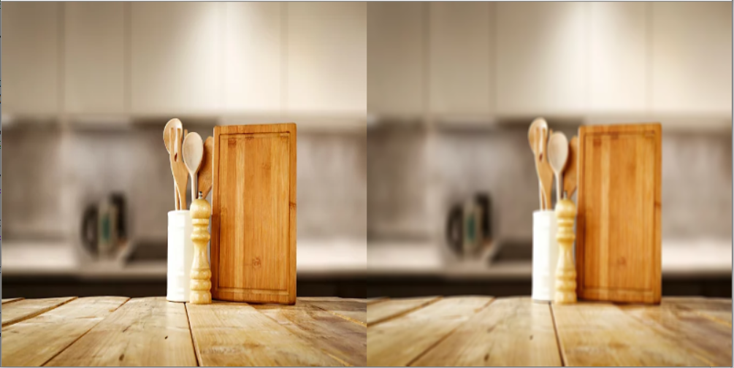
AVERAGE FILTER

Slide 14
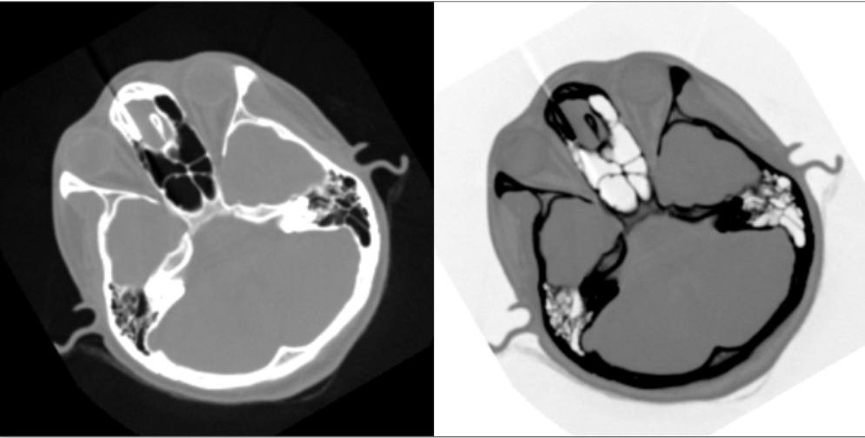
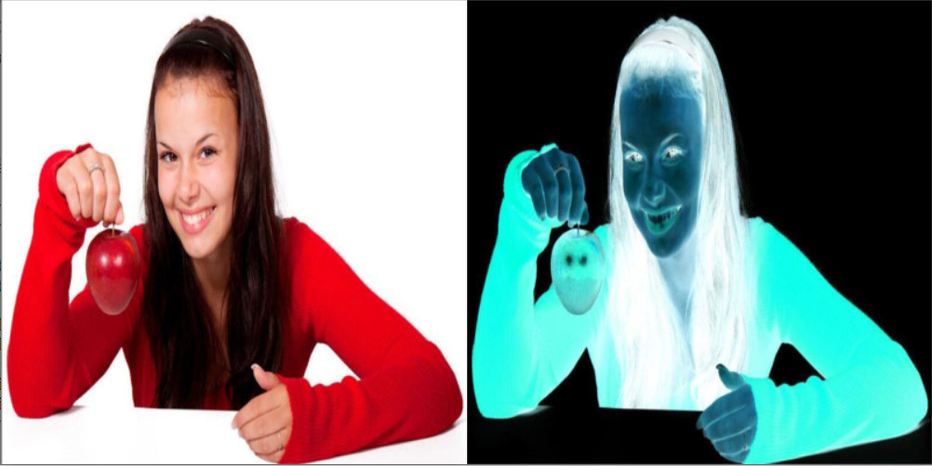
NEGATION

Slide 15
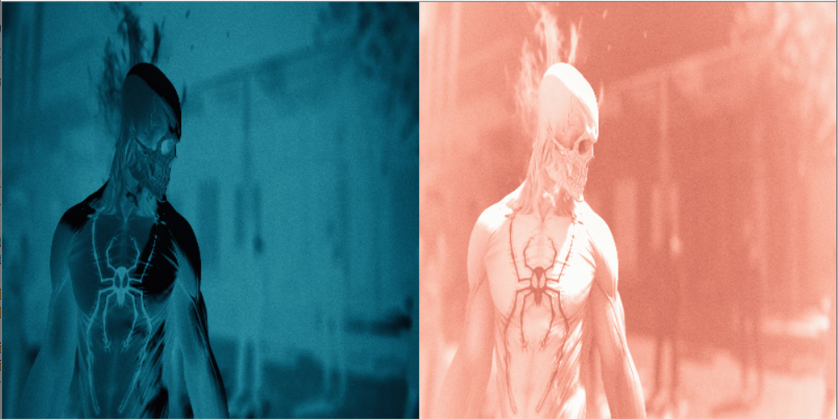
NEGATION

Slide 16
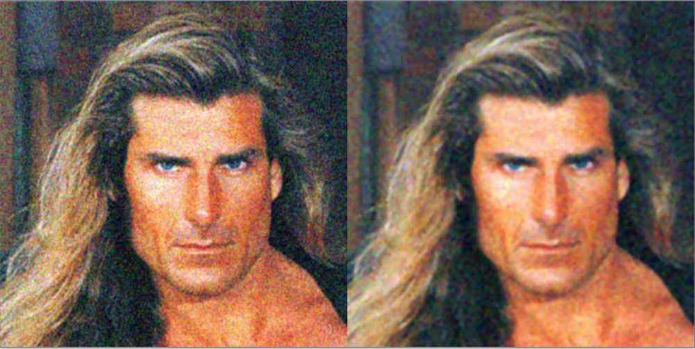
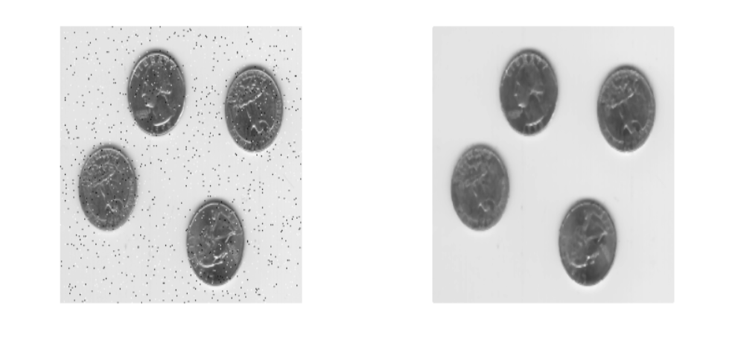
MEDIAN FILTER

Slide 17
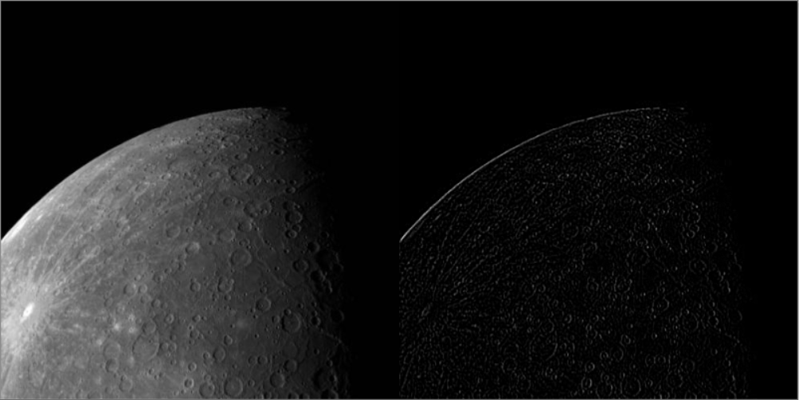
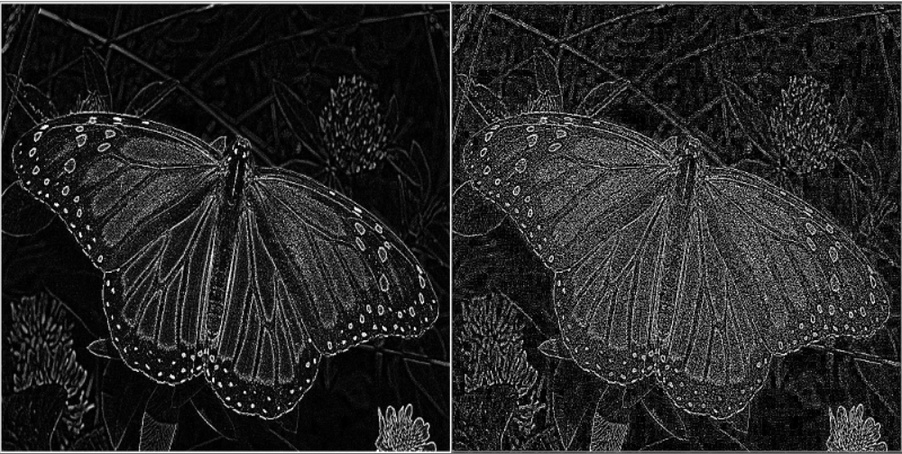
LAPLACIAN BLUR

Slide 18
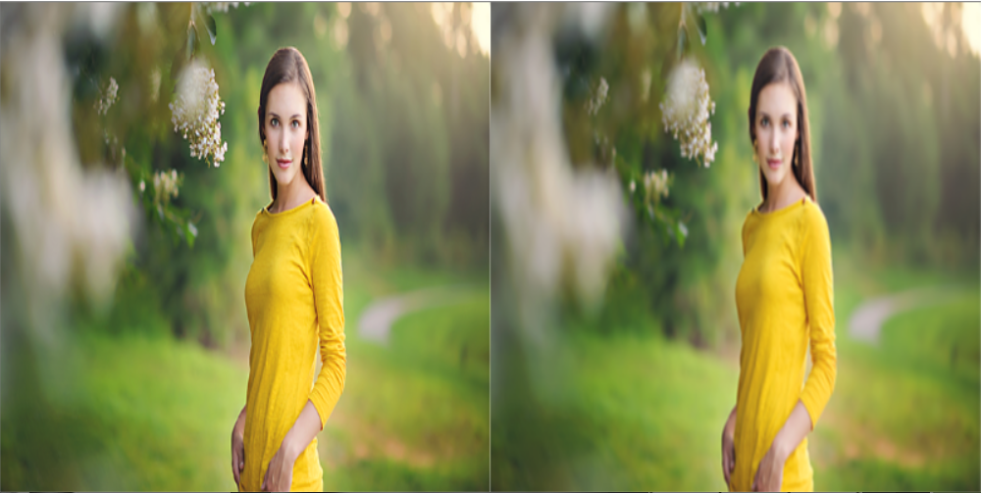
GAUSSIAN BLUR

